Slide 1
Fizzy

Slide 2
Intro to fizzy

Slide 3
Design Comments
Reached the limit of the weights of all components
Min weight shell~300g (with 3d printing this is most likely close to the limit)
Min weight suspension ~20g (most weight located in the fixed axis)
Min weight drivetrain ~130g
Current prototypes do not roll well because of mass ratio drivetrain/shell
With Sphero it is around 3
With Fizzy it is around 1/2
With a more compliant shell also comes an increase in surface contact, which has a negative influence on the rolling resistance
Making the shell softer can reduce weight but increase roll resistance. A proper optimization could be done on this

Slide 4
Recommendation
Look into inflating option -> this could reduce the shell weight, and you can change the stiffness better and it does not deform overtime (creep of the tpu shell/suspension)
Look into lightweight volleyball ~200-230g https://www.volleyballdirekt.de/molten-v5m2000-l-volleyball-unisex-118055.html?gad_source=1&gclid=Cj0KCQjw3vO3BhCqARIsAEWblcCP1XpONOxnJmjxGIB1c85enQjzTlYxwvYX6yYS9CZwmnbH_TVQjPsaAsnWEALw_wcB
Look into adding foam to sphero like is done in this post: https://www.instagram.com/fontysvenlo_ide/p/C8XPsrZMmkp/?img_index=2
Increase weight drivetrain like they do with other toys (sphero, cat toys).
Center of gravity of drivetrain can be placed closer to the shell by a few millimeters but no significant change can be made here.
Look into different materials of the shell
TPC is more rubbery and springs back like a rubber band instead of the more dampening/viscous behavior of TPU
Different TPU types also make a difference in bounciness and density
Look into metamaterial construction for the shell
Use constant force mechanism to protect the whole system (when battery is turned 90 degrees). Place it lower and make it longer so it goes around the PCB and battery.

Slide 5
Recommendation
Perform test on influence of counterbalance
My hypothesis would be that it does not matter to much for being a normal ball again, given that the drivetrain is statically balanced with the fixed axis.
Perform test on influence of off-centering the drivetrain
Richard (bachelor student) had a first go with it, but did not find conclusive results
Implement a test IMU that can measure the impact inside the ball with the new suspension design, or different suspension designs and shell types to validate its characteristics: https://www.artisantg.com/TestMeasurement/95467-1/Amphenol-PCB-Piezotronics-356A33-Triaxial-Ceramic-Shear-ICP-Accelerometer?srsltid=AfmBOoqv5LIQdKkRx0TayMk6EnAl6bxg1QnT6kAnZTeAzufdufXTRGrGhttps://www.ni.com/pdf/manuals/TriaxialCeramicShearAccelerometer1.pdf?srsltid=AfmBOopYDMbj4CzPchYFIvIgBjQxtM3VX5_q8JcEDcbKgHbnpP3XAd72
If a smaller version is preferred, I would recommend to put a shell around Sphero that is soft, this is a lot easier than redesigning the current prototype. If this is nevertheless required: get rid of the belt drive and constant force springs, take a smaller battery and redesign the chassis for robustness. Use a gear connection from the fixed axis to the motor. Redesign the PCB to fit a smaller area.
Drivetrain is not yet tested for high impacts
Adding a bumper could add weight to the appropriate places and increase robustness

Slide 6
Fizzy components
Components
Shell
Suspension
Drivetrain
Overall requirements
Robust
Compliant shell
Inertia tensor like a normal ball
Weight like a normal ball

Slide 7
Shell
Requirements:
Lightweight <400g
Robust against impact
Shape must remain like a ball (at least to the naked eye)
Enable access to the electronics inside (for charging and turning off and on, and inspecting if something is broken)
Ease of manufacturing (3D printed, glued, welded and sewn together)
Ease of adaptability (no hex pattern that is harder to adjust)
Wishes:
Bouncy
Nice touch from the outside
Easy to open, when still needed for turning off/on and charging

Slide 8
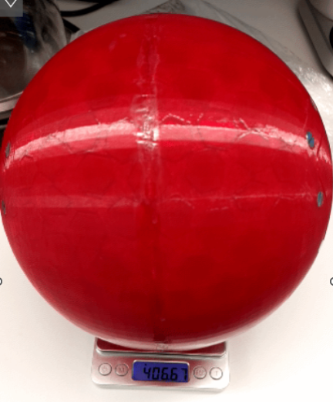
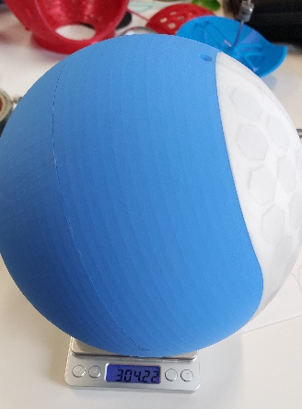
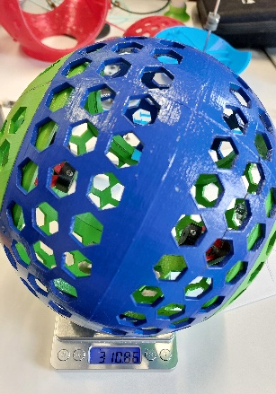
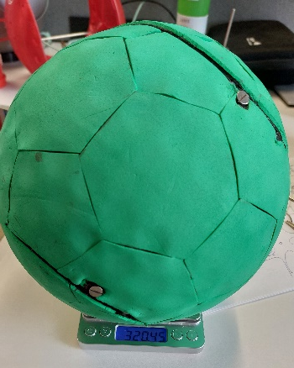
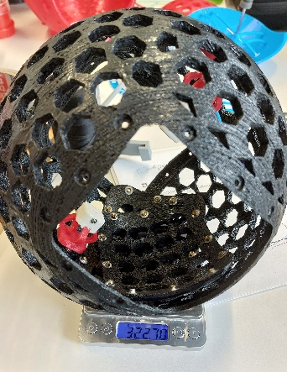
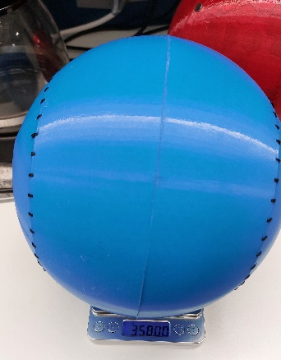
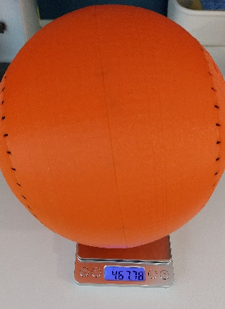
Prototype Shells
Rigid
Compliant
Material | PLA | PLA | TPU + foam patting | TPU 95A (Amazon) | TPU95A HF (polymaker) | TPU95A (polymaker) | TPU95A (polymaker)
Shell design | Baseball | Baseball | Baseball | Trapdoor | Trapdoor | Baseball | Baseball
Weight including suspension | 304g | 310g | 320g | 322g | 406 (without suspension) | 358g | 313g
Wall thickness | 3mm | 5mm | 6mm | 6mm | 6mm | 4mm | 4mm
Infill | 15% | 15%? | 20%? | 20%? | 15% | 15% | 15%
Connection method | Screws | Screws | Screws/ magnets | Screws | Screws | sewing | Sewing
Contact area with ground | Small | Small | Big | Big | Medium | Big | Big
Comments |  |  |  |  |  | Printed with double walls (as is default) | Single wall on inside, fuzzy skin on outside

Slide 9
Current shell versions
Robust version
Rigid version
Material: TPU 95A polymaker (3D printed)
Form: baseball
Ease of manufaturing, printing it in this shape does not need support
More uniform distribution of mass compared to trapdoor
Thickness: 4 mm
Thinner would lead to problems with strength at the sewing connection
Thinner can also lead to shifting of the layers of the shell over each other instead of against
Stitches
10 mm apart with 1mm thick waxed thread
Stitching must include a loop connecting opposing holes. Otherwise the stitch is too weak.
Picture
Picture

Slide 10
Current shell versions
Trapdoor (red ball)
Lego version
Make easy lego version, adapt
LEGO Mindstorm version: 217.11g?
Picture
Picture

Slide 11
Suspension
Suspension options
Compression
Tension
Linear guide

Slide 12
Suspension
Requirements:
Rotational stiff (can hold the drivetrain in 90-degree angle with minimum deflection)
As stiff as possible in all directions but not detectable from the outside
When you deform the shell, you ideally don’t want to feel the suspension
Lightweight, but balanced out with the drivetrain weight to balance it out when in folded position
Enough space for the drivetrain to rotate, including a buffer of a view centimeters
Strong enough against impact
Main issue being the connection points, connection to the shell and to the axis
Wishes
Ease of manufacturing
Ease of assembly
Low cost, use standard components

Slide 13
Suspension
Explain current suspension systems:
A suspension system like the one in the FIFA ball is preferable because the system is under tension. So when the shell is compressed you will not feel the suspension.
Location of the suspension system is highly depended on the mass of the drivetrain as well as the suspension
An optimization can be done on getting the right location of the suspension with maximizing a certain outcome for the ball. For example, the starting acceleration
Bottle necks of the suspension:
The amount of space needed for the drivetrain
Making sure the drivetrain is indeed in the intended position
Assembling the suspension

Slide 14
Suspension
Bicycle hub
Claws
Under tension
Holes in the shell
One part
Deforms the shell a little
Very lightweight options
Under compression or with linear guide
Works in terms of rotational stiffness
Multiple parts
Connection to the shell is weak
Cannot be made much lighter
Picture
Picture

Slide 15
Drivetrain
Components
Motor
Bearings, axes, pulleys
Constant force mechanism (CFM)
Battery, Microcontroller
Power Management, Sensors

Slide 16
Drivetrain
Requirements:
Robust against direct impact
Robust against torque overload
Center of mass as close to the shell as possible (using the heaviest components in the lower part of the construction)
Low-cost components
Ease of manufacturing
Ease of assembly
Long battery life (high battery capacity as well as low battery consumption during operation)
Minimal use of sensors

Slide 17
Drivetrain: Motor
Requirements:
Minimum Torque: weight drivetrain * g * moment arm
Moment arm is the distance from fixed axis to center of mass drivetrain)
Which comes down to ~0.05 Nm with current drivetrain
Minimum speed: similar to Sphero
1 m/s of the whole ball results in around ~100 rpm of the motor
Size: as compact as possible
Most motors need a coupling to the driving axis and are placed inline with the axis. Together with the need for space for support bearings of the driving axis because the motor bearings can not hold the load. The whole setup becomes quite long quite fast.
Cheap and available
Transmission can handle shocks and torque overload
Pulley
coupling
Gears
M
Center line

Slide 18
Drivetrain: Bearings, axis, pulleys
Bearings
The bearings are load bearings on the drivetrain side when impacted
Little test with planer bearings showed that the friction is too high for normal operation
Friction ball bearings ~0.005 Nm (10% of required torque)
Friction planer bearings ~ 0.015 Nm
Axis
…
Pulleys
See master thesis Bart

Slide 19
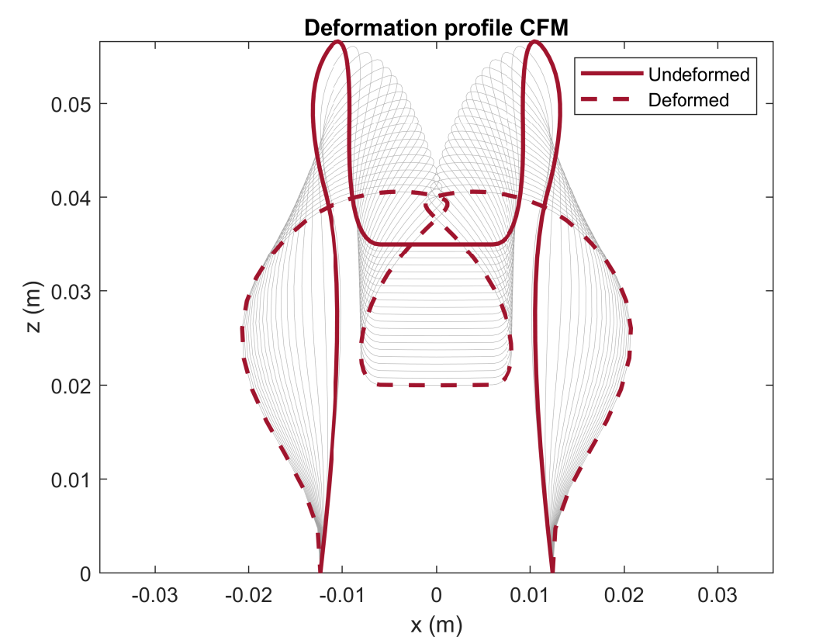
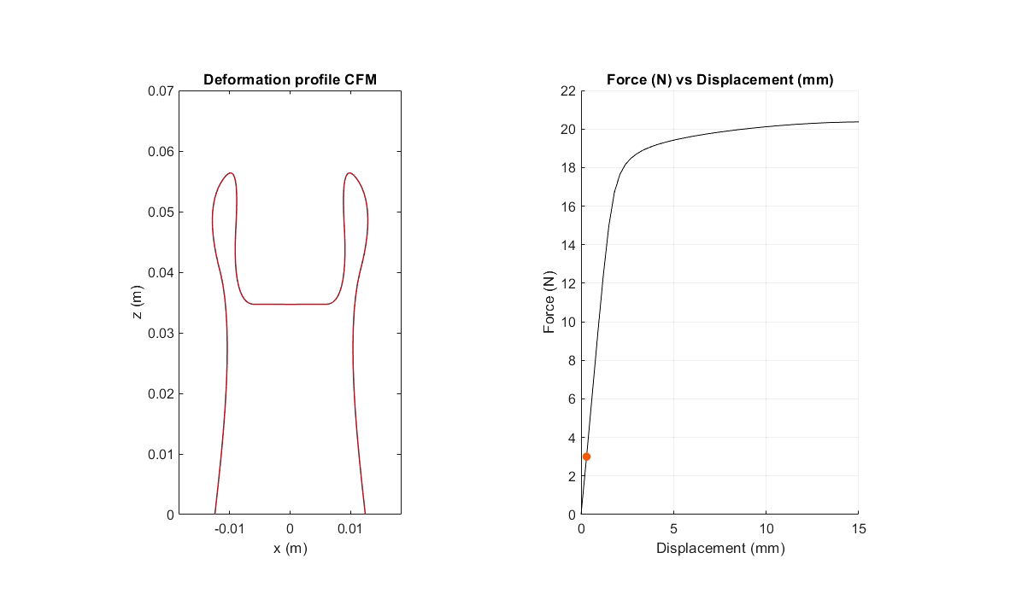
Drivetrain: CFM
See master thesis Bart

Slide 20
Drivetrain: Battery, microcontroller
Researched by Michael Fritschi
Battery
Chosen for a standard battery that is used in a wide variety of products
It has a high capacity and good max current output
A different form factor could be help full but mounting the battery in the current setup is easy to do
A cylinder is also more robust against impact compared to a flat battery
Microcontroller
ESP32 has the wifi modules and is easy to program.
Its small and cheap

Slide 21
Drivetrain: Sensors, Power Management
Researched by Michael Fritschi
Sensors
IMU
Possible encoder on the driving axis
Options:
Power management
Chosen for a step-up converter to 5V for the motor and then down to 3.3V for the rest of the electronics
The battery has between 4.2V and 2.5V
ESP32 needs 3.3V
Sensors need 3.3V
Motor needs between 4.8V and 6V
With this configuration you burn more energy, but it is more robust against high current draws from the motor

Slide 22
New Drivetrain design
Extent pulleys to fit over motor connection
Use 4mm bearings (2x7x4mm)
Use plastic gear continuous motor
Bumber integrated with push button to be robust

